Slide 1
Library Management System
Python CLI project with SQLite database
Bhandari Prajwal
ID: 25013467
Sejong University
GitHub: github.com/prajwal3550/Library_Management_System

Slide 2
Project Overview
Purpose
1.Manage a small library book inventory
2.Store book records permanently in SQLite
3.Provide simple menu-based console operations
4.Reduce manual tracking errors
Main Users
1.Library staff
2.Students managing mini-project inventory
3.Beginner Python learners studying CRUD operations
Core idea: one menu loop controls all book operations and updates the SQLite database after every change.

Slide 3
Tools and Features
Python
SQLite
Main programming language for the command-line application.
Stores book id, title, author, and quantity in a local database.
CRUD
Circulation
Add, view, search, update, and delete book records.
Issue and return books by changing available quantity.

Slide 4
Database Design
SQLite table: books
id: INTEGER PRIMARY KEY AUTOINCREMENT
title: TEXT NOT NULL
author: TEXT NOT NULL
quantity: INTEGER NOT NULL
The quantity field is increased when a book is returned and decreased when a book is issued.
books
id Primary key
title Book name
author Writer name
quantity Available copies

Slide 5
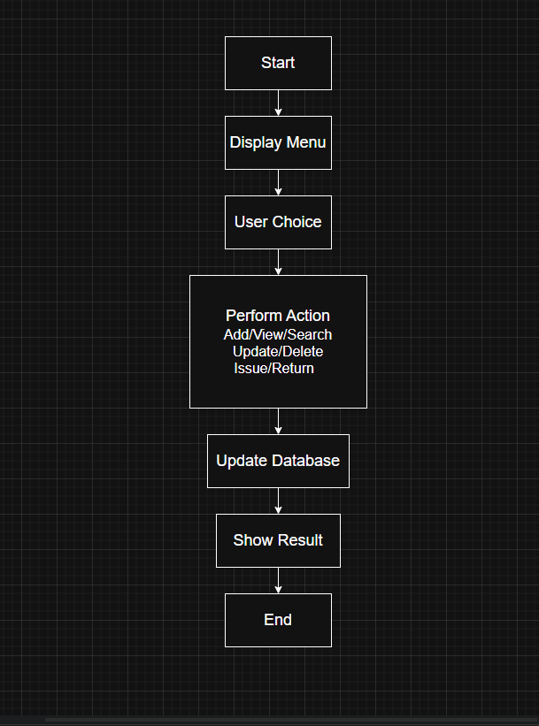
Program Flowchart
Execution Flow
1.Start the program and display menu
2.User chooses an operation
3.Selected function performs database action
4.Updated result is shown in terminal
5.Program repeats until Exit is selected

Slide 6
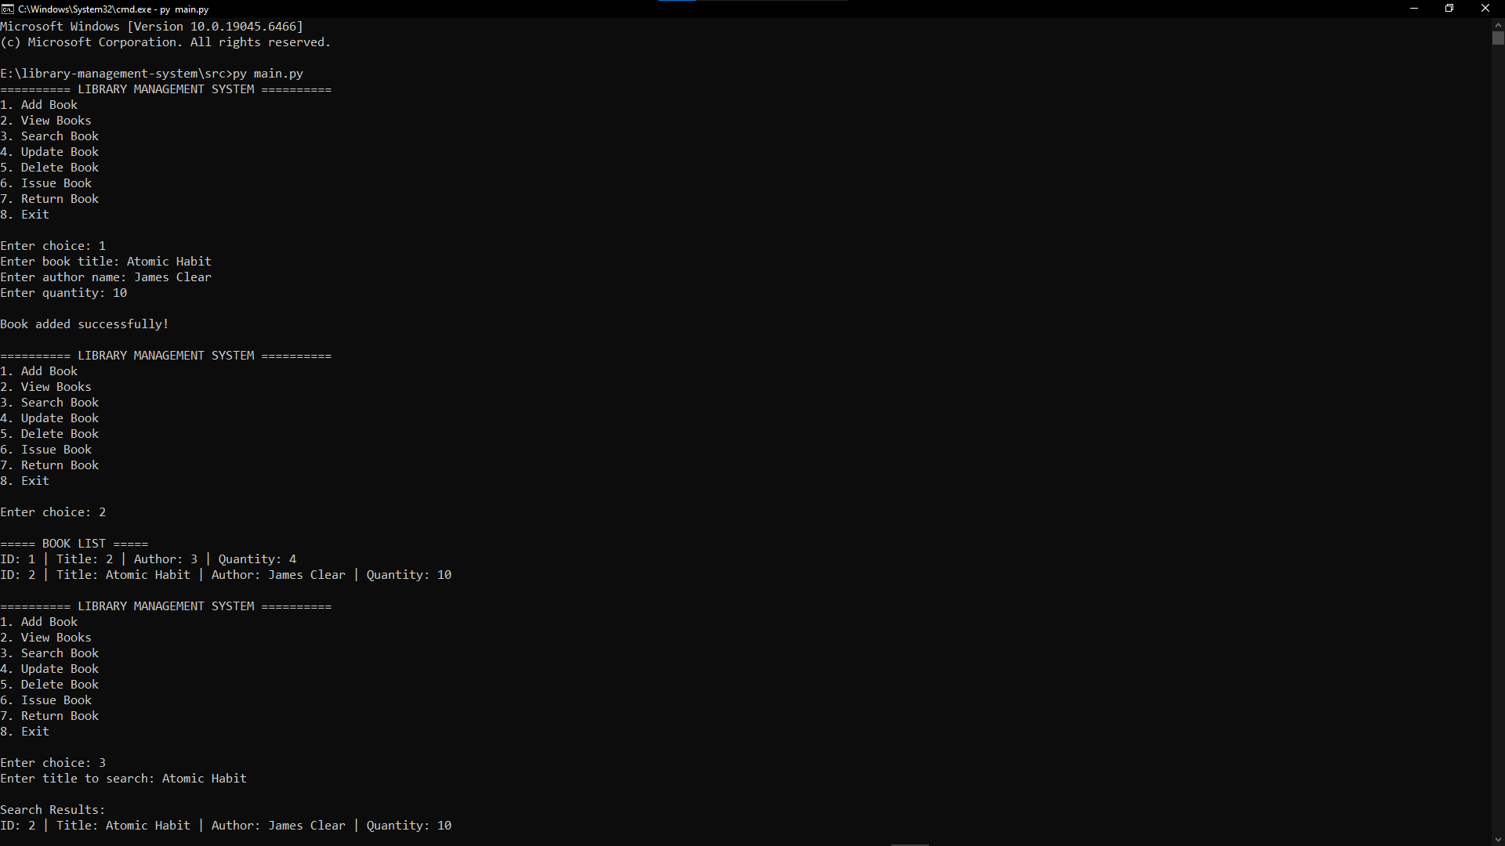
Demo Output: Add, View, and Search
This screenshot shows adding Atomic Habit, listing stored records, and searching by title.

Slide 7
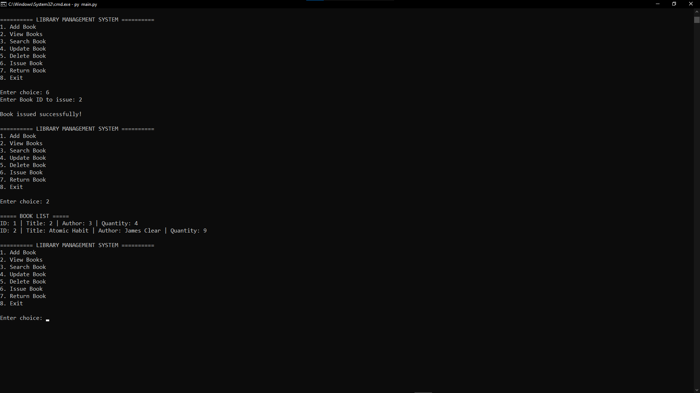
Demo Output: Issue Book
After issuing book ID 2, the available quantity changes from 10 to 9.

Slide 8
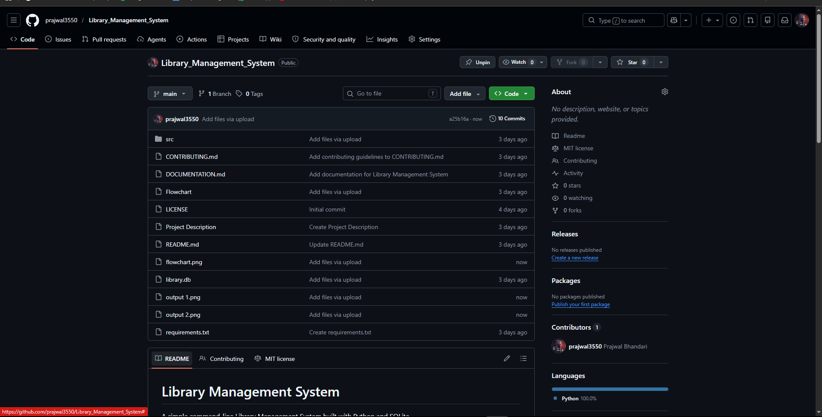
Github Repository
https://github.com/prajwal3550/Library_Management_System.git

Slide 9
Conclusion
The Library Management System demonstrates a complete beginner-friendly database application using Python and SQLite. It supports essential inventory tasks, keeps data persistent, and gives clear terminal feedback after every operation.
Presented by Bhandari Prajwal | ID 25013467 | Sejong University

